Slide 1
Vegetable Revision 1

Slide 2
Base and top dressings
Essential nutrients:
Nitrogen (N) – soluble and so very prone to leaching, needs continuous replenishing.
Organic – Blood, fish and bonemeal.
Artificial – Ammonium sulphate, Ammonium nitrate.
Phosphorus (P) – may be applied as Superphosphate, Phosphorus is not prone to leaching (insoluble) but may be unavailable to plants
Potassium (K) – may be applied as Potassium sulphate , Potassium is soluble but potash is slow to be washed out of soil.
A regular annual application of garden compost or farmyard manure (FYM) is usually enough to maintain base levels of Potassium and Phosphorus. Growmore is a compound fertiliser containing equal parts N, P and K.

Slide 3
Base and top dressings
Base dressing – Manure is incorporated when digging during initial soil preparation, general fertilisers are raked in once soil is prepared about 2 weeks prior to planting. N is applied in spring rather than autumn to prevent it leaching out as a result of winter rain. P and K may be applied all year round.
Lime may also be applied as a base dressing during soil preparation to raise the pH of acidic soils and make them suitable for plant growth and in some cases disease suppression (Clubroot in brassicas).
Liquid feeds can be given during the growing season to boost growth as needed.

Slide 4
Thinning
Thinning is the practice of removing overcrowded seedlings in order to allow the remaining plants the space they need in order to mature.
Crops such as carrots are thinned to their final spacing in stages which prevents crooked root formation and the healthiest specimens to be left in situ.
Thinning allows for improvement in air circulation around plants thereby reducing the risk of fungal infection.

Slide 5
Weed control
Weeds compete with crops for light, air, water and nutrients.
Weeds act as reservoirs for certain pests and disease.
Weeding:
Weeding by hand is the best option to prevent damage to plants.
Hoeing weeds at seedling stage if space permits on a warm, dry day desiccates them and is less labour intensive.
Use of mulches helps with weed control

Slide 6
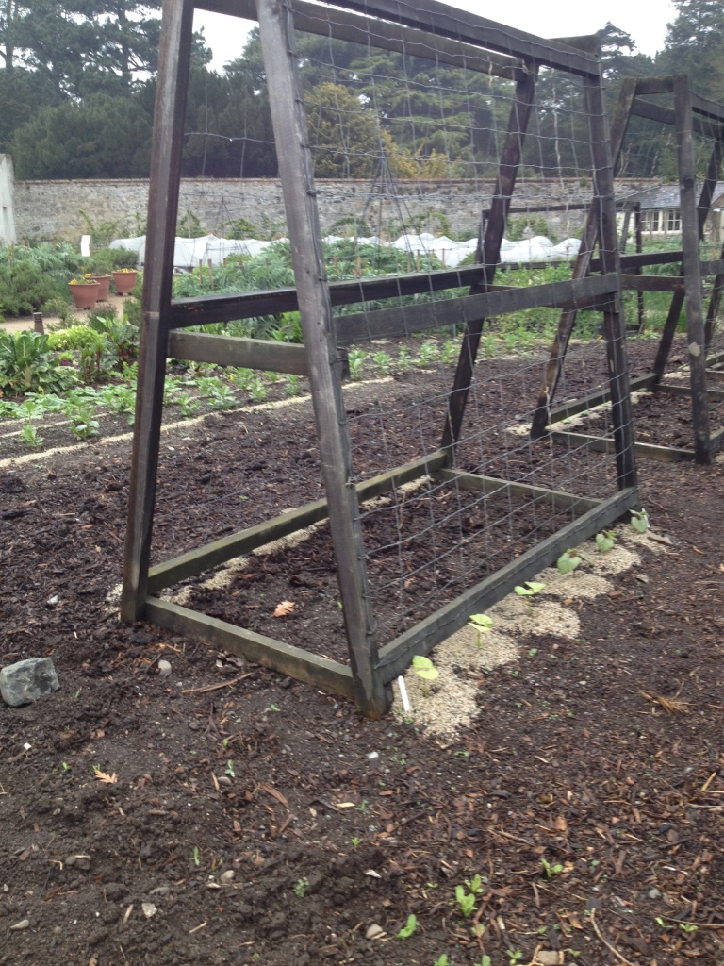
Crop supports
Some plants need a climbing frame such as peas, beans etc. to allow them grow properly and maximise yield and ease of harvest.
Other crops may require staking for stability especially tall crops in a windy location such as Brussels sprouts, Kale etc.

Slide 7
Irrigation
There are a number of critical periods in plant growth when timing of irrigation is essential:
During flowering e.g. strawberries
During fruit development e.g. courgettes
In the above types of crops watering heavily before the critical period will cause excessive vegetative growth at the expense of flowers and fruit.
However crops where the leaves are the economic sink require frequent watering to produce a good crop e.g. brassicas, lettuce and other leafy crops.

Slide 8
Pest and disease control
Pest and disease control is essential to maintain quality and ensure good yield. Practices that help with good pest and disease control include:
Practicing good crop rotation
Good hygiene practices including weed control and removal of debris.
Protection using physical barriers
Floating mulches as a barrier to some pests
Use of baits and traps for pests such as mice, voles, snails, slugs etc.
Maintaining good plant health by ensuring good nutrition and watering regimes.
Use of certified seed
Use of resistant cultivars

Slide 9
Harvest Methods
Runner beans | Winter cabbage | Brussels sprouts | Carrots | Courgettes | Onions | Leeks | Beetroot | Lettuce | Radish
Harvest before beans swell when pods are 15cm-20cm long. Harvest regularly to promote continued flowering | Cut across base of stump to remove with a sharp knife. Will get a second crop of small heads | Harvest when sprouts are walnut sized and closed tightly. Snap sprouts off the stem, working up from the bottom. | Pick as required when mature from June onwards. | Pick courgettes when the fruit is about 10cms long to ensure continued production. | Once the leaves have withered and died back onions may be lifted. | Dig up as needed | Start lifting from when they are golf ball sized for baby beets removing every second one. Once the others have matured lift and twist off foliage. | Loose leaf cultivars may be treated as cut and come again, other varieties when the head is firm or mature. Harvest early morning | Harvest as soon as roots are large enough and still fleshy before they get too large and woody.

Slide 10
Storage of harvest
Runner beans | Winter cabbage | Brussels sprouts | Carrots | Courgettes | Onions | Leeks | Beetroot | Lettuce | Radish
In fridge at 4°C Cut, blanch and freeze | Harvest for immediate use. Storage not necessary. Pickle red varieties | Harvest for immediate use. Storage not necessary. If plant was ‘stopped’ the cut across stem to harvest as this will keep sprouts fresh longer | Carrot crops lifted in October may be stored until march in a mix of damp sand and peat | Use as quickly as possible after harvest. May be pickled as chutney. | Store in a dry well ventilated location out of direct sunlight either in a single layer in a slatted box or with plaited stems hung up. Use as required from lifting time onwards | May remain in the ground over the winter | Eat young foliage as salad leaves. Leave a crown of stalks attached to root to prolong storage life and prevent bleeding. May be pickled. | Use straight away. | May be left in soil during winter. May otherwise be stored in damp sand.

Slide 11
Crop rotation
Benefits:
Because different crops have different nutrient requirements then a good crop rotation reduces the possibility of a certain nutrient deficiency developing in the soil.
Crops with large canopies crowd out weeds and leave the soil cleaner for following crops thereby reducing maintenance.
Crop rotation helps prevent the build up of soil borne pests and disease by removing the host plants after one growing season and giving the pest/disease a chance to die out.

Slide 12
Crop Rotation
Limitations:
There may be a space limitation in the garden which will not allow some larger crops in the rotation e.g. potatoes
Some crops used in a rotation may not be suitable because of soil type etc. e.g. carrots
Perennial crops such as asparagus, artichokes, rhubarb etc. will not fit into a rotation programme and require a permanent space.
Not effective against non-soil borne pests and disease.

Slide 13
Successional planting
Advantages:
Too many seeds in a pack which would create a glut if planted all at once. Successional planting means planting at regular intervals to spread out the harvest and avoid gluts.
Crops such as spinach and lettuce are best sown in small batches to provide a continuous fresh supply as they are perishable.
It is an essential method to ensure continued cropping in plants prone to bolting such as coriander.
Allows a range of maturing rates to be utilised effectively.
To extend the season sow indoors in seed trays from early February and plant out in March under cloches or fleece.
Sow outdoors in late July for an autumn crop.

Slide 14
Successional planting
When to sow:
Outdoors – Every one to four weeks but usually fortnightly from early spring to mid summer.
Indoors – from early spring onwards
Sow different varieties of the same crop as early and late season varieties mature at different times of the year.
Example - Butterhead lettuce, ‘Tom Thumb’, ‘Butter Crunch’ and ‘Diana’

Slide 15
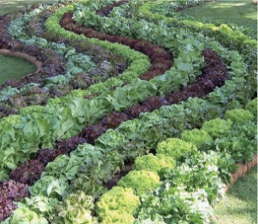
Intercropping
Intercropping is where quick maturing crops are grown between slower growing crops to maximise space and productivity.
Examples include:
Lettuce between brassicas
Radishes between carrots or parsnips
Spring onions between sweetcorn

Slide 16
Spacing
Adequate spacing allows:
Roots expand without restriction
Allows water, light and air between the roots
Ease of weed management
Typical spacing for a carrot crop is 5cm apart which allows for maximum yield
Closer spacing increases competition between plant roots but allows:
Production of baby carrots
Uniformity of production

