Slide 1
Growing Potatoes in Barley Straw

Slide 2
Potatoes can be grown in organic barley straw.
The concept is that the potatoes are planted at their normal spacing, but only at 1 inch below the ground.
Potatoes are covered over with approximately 18 inches of organic barley straw. It can be netted to prevent it blowing in the wind.
Once a week it is important to spray the barley straw with a tomato feed at normal dilution, this will ferment the straw.
The advantages are that slugs, snails and wire worm will not survive normally in the barley straw (too hot!) and therefore no more holes in the potato.

Slide 3
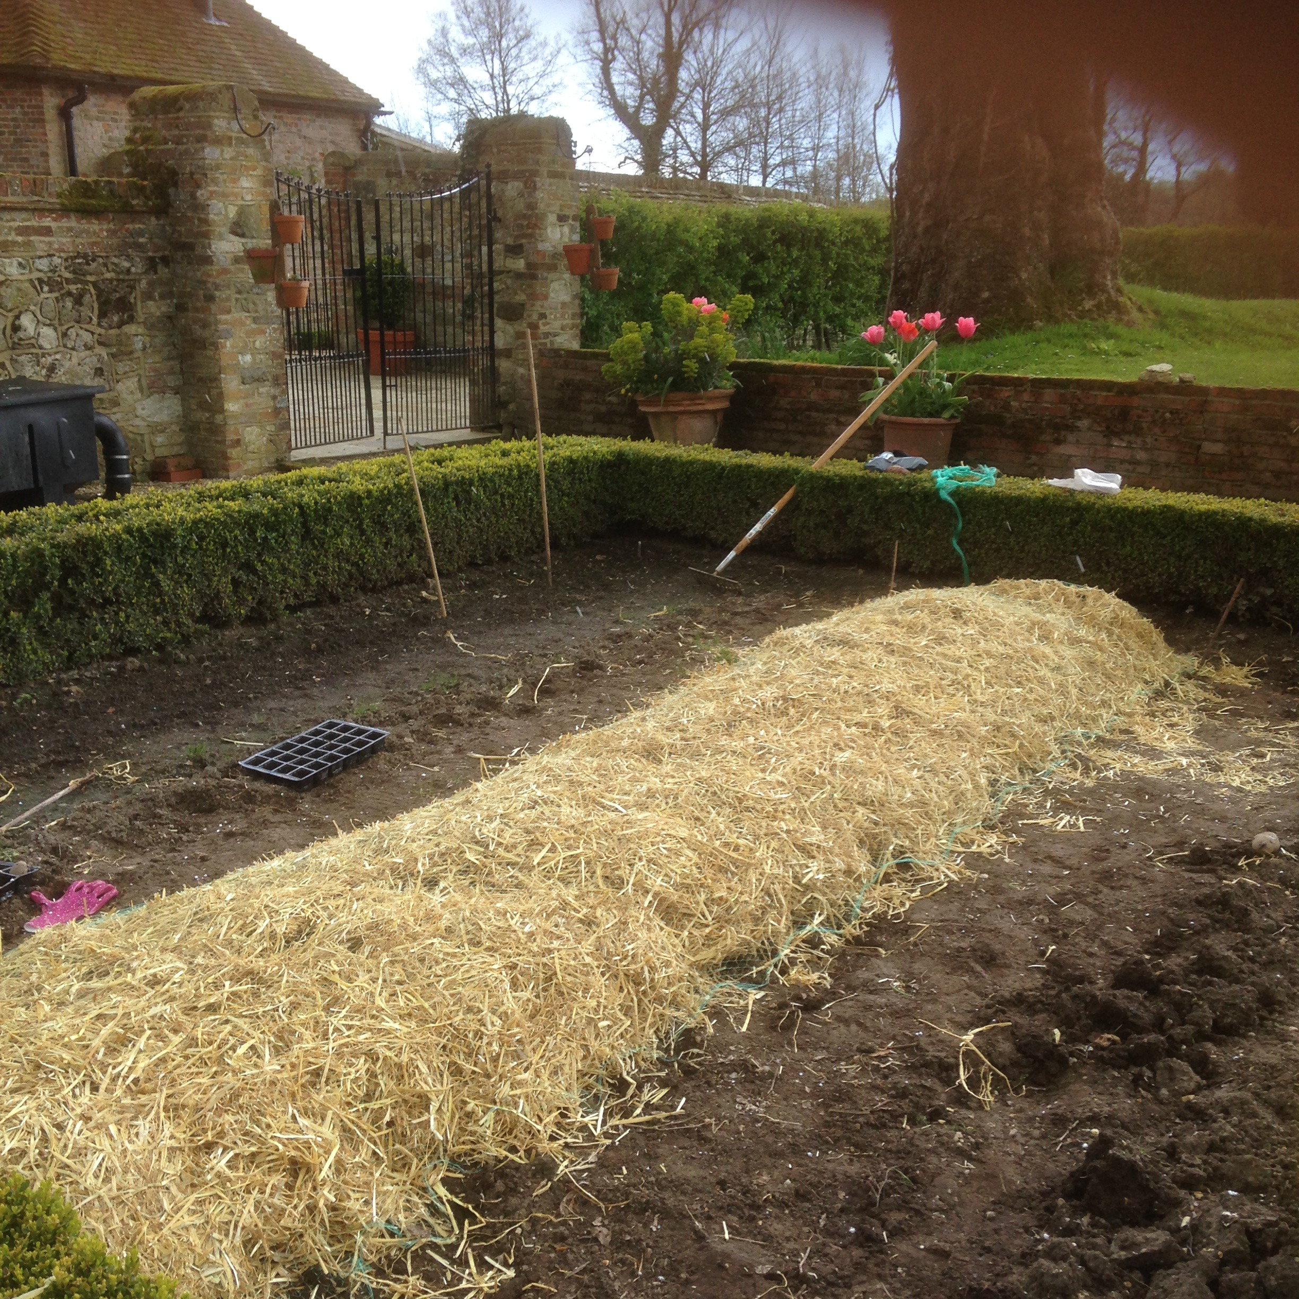

Slide 4
