Slide 1
Nettle Compost Tea

Slide 2
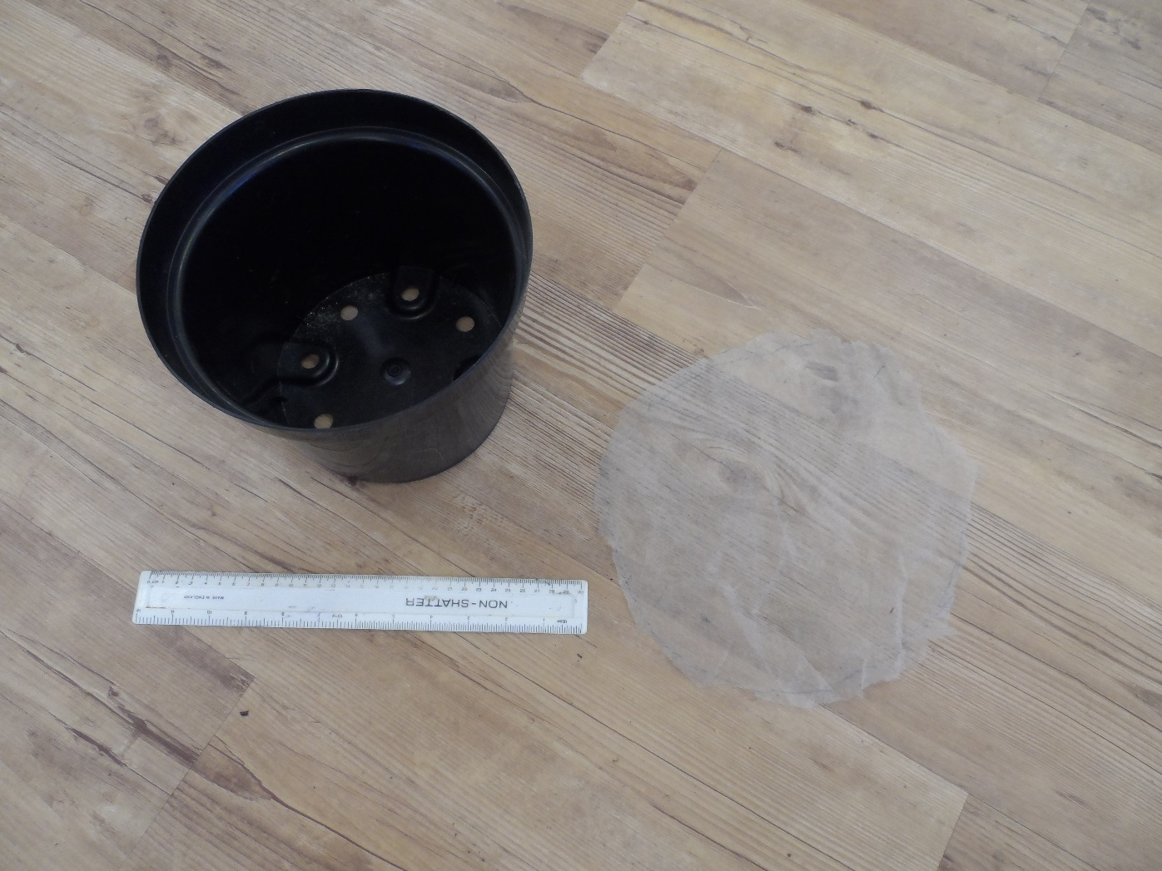
STEP 1: The Equipment. Red arrow = 25cm pot. Yellow arrow = Horticultural fleece.

Slide 3
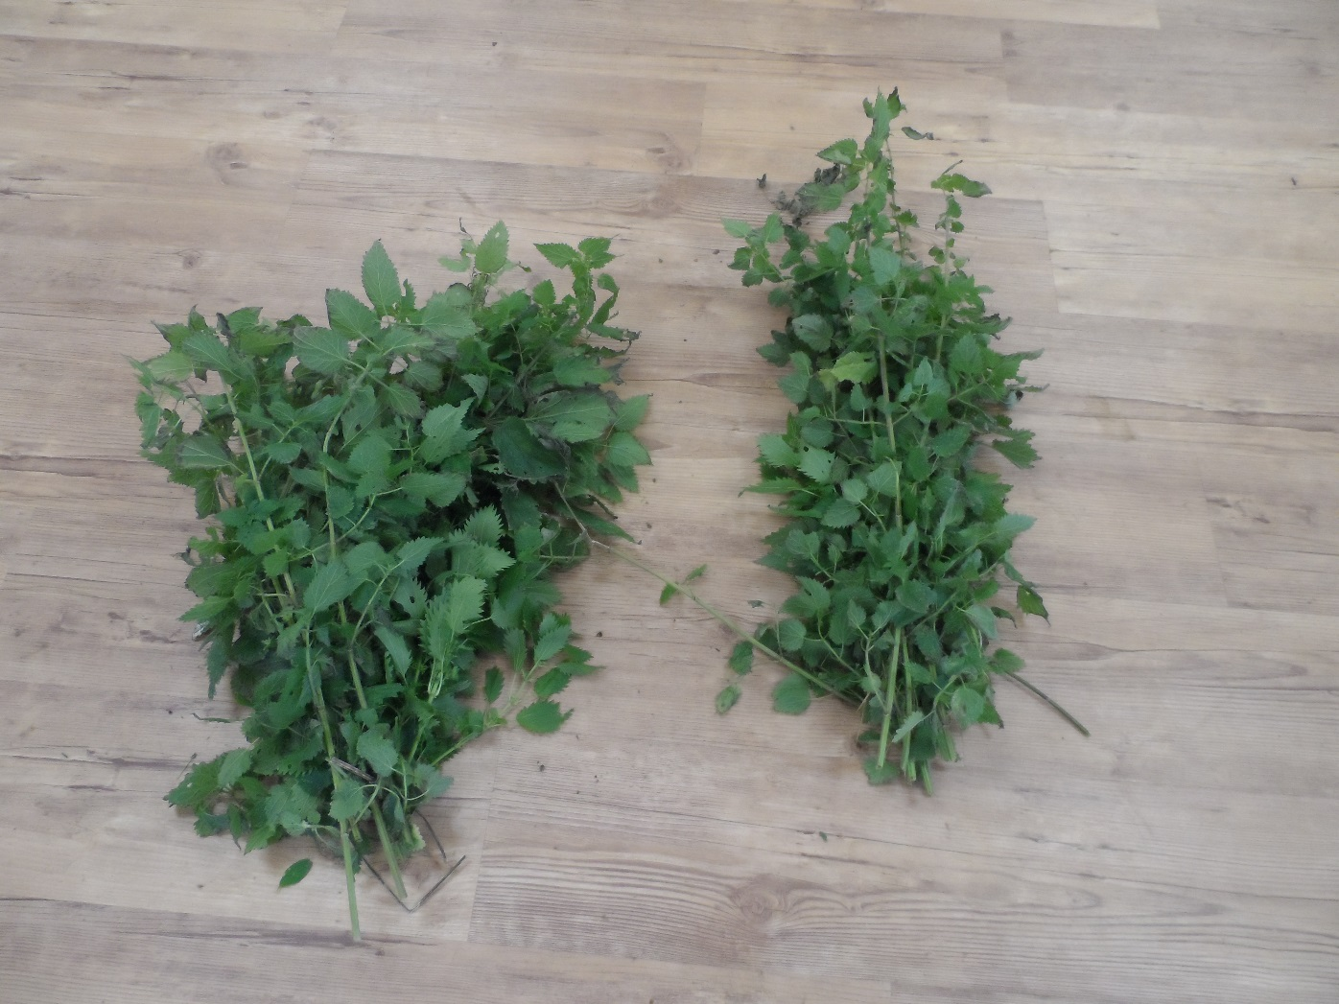
STEP: 2 The fresh Urtica dioica.

Slide 4
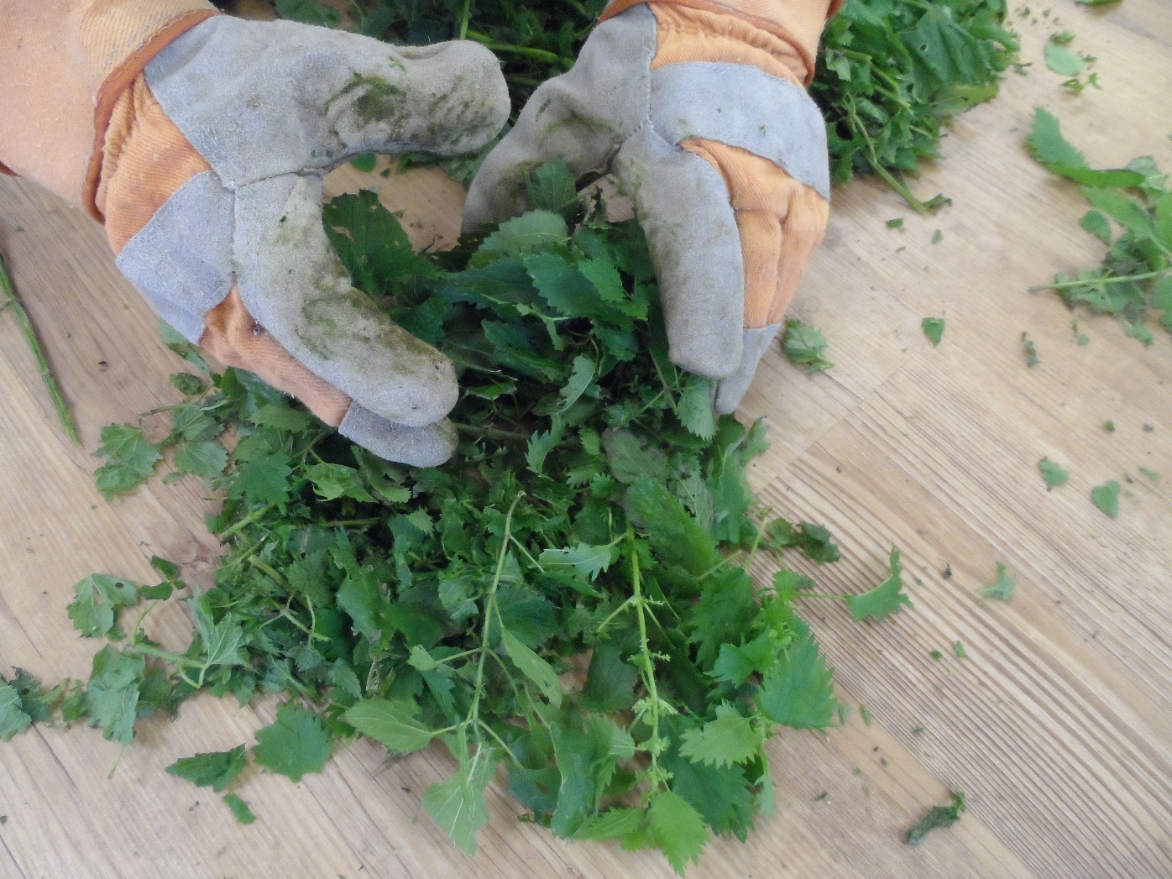
STEP: 3 Breaking up the Nettles.

Slide 5
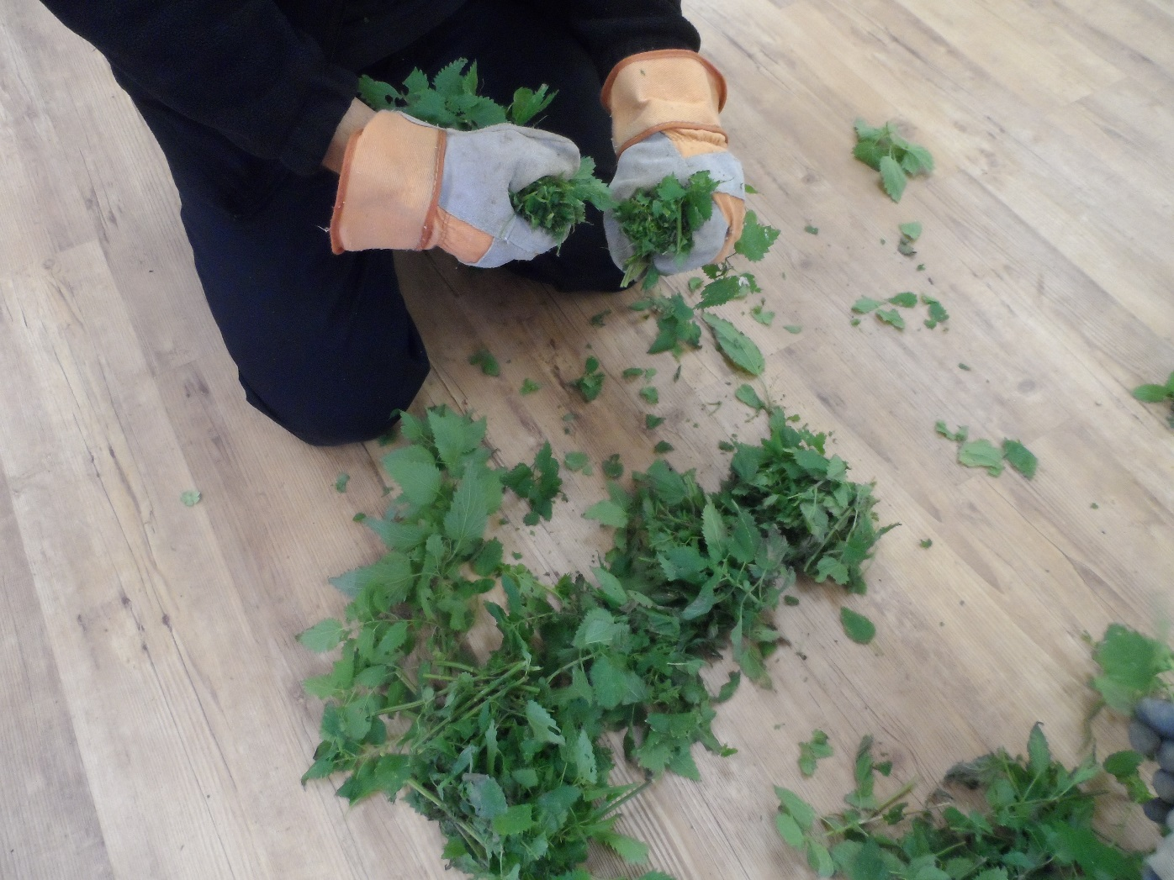
STEP: 3 Breaking up the Nettles.

Slide 6
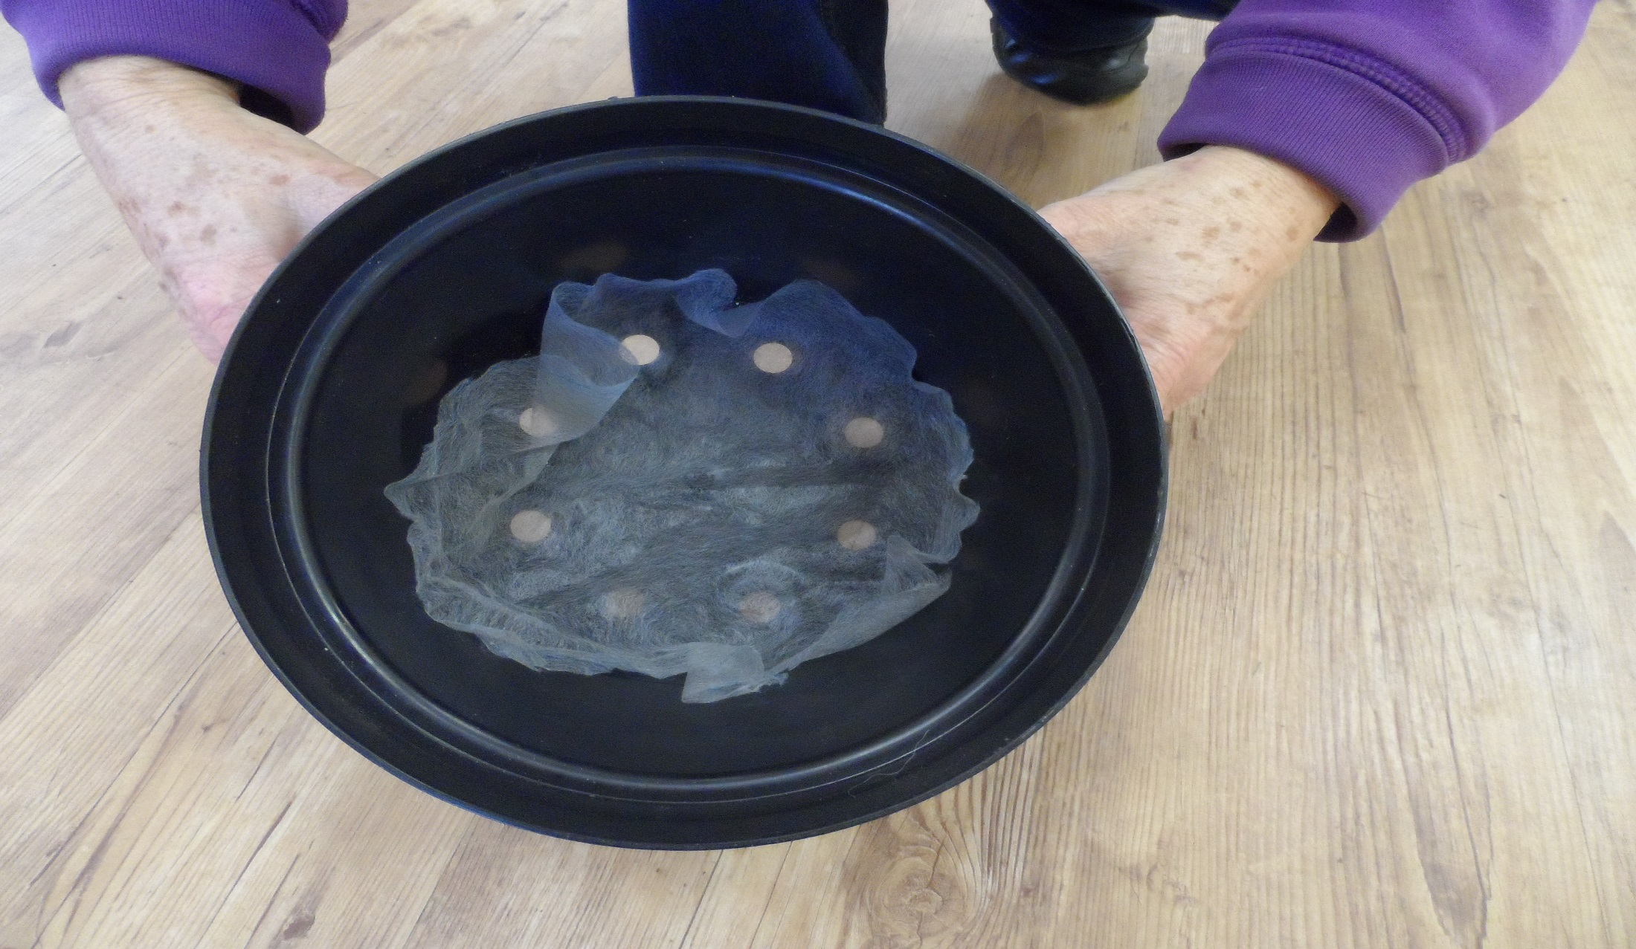
STEP: 4 Fleece in the bottom of the pot.

Slide 7
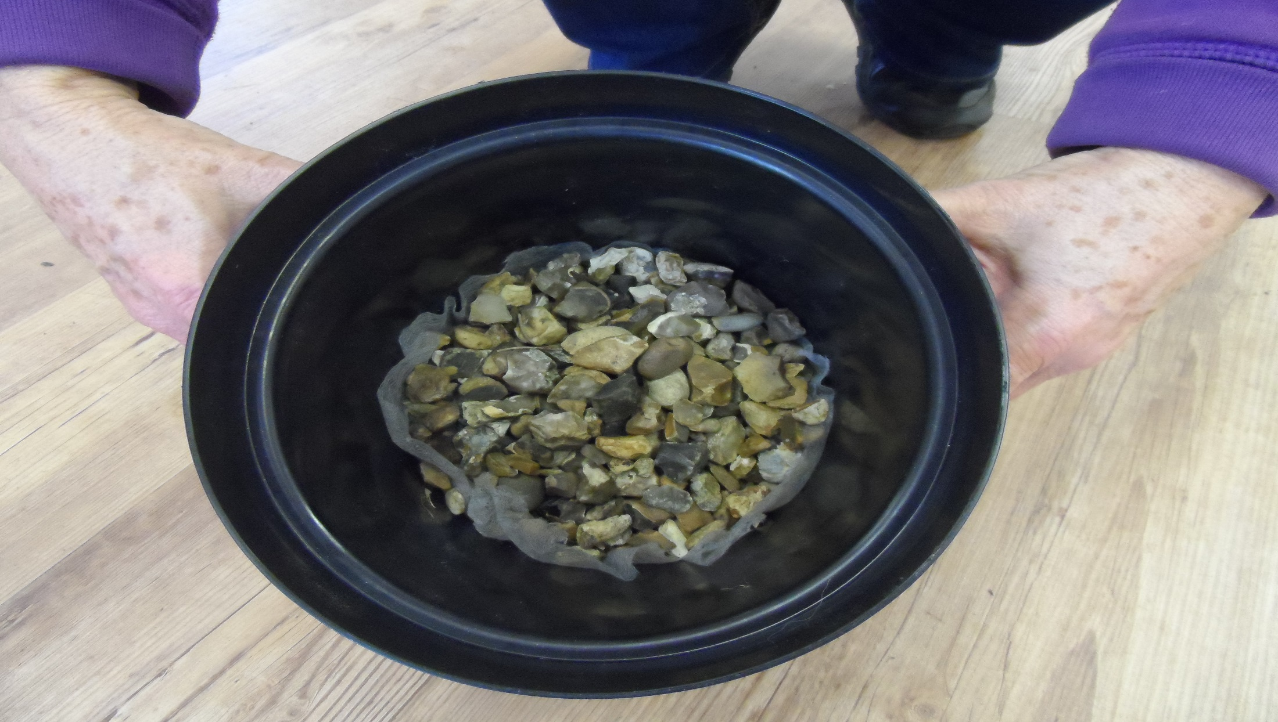
STEP: 5 Aquatic stone in the bottom of the pot.

Slide 8
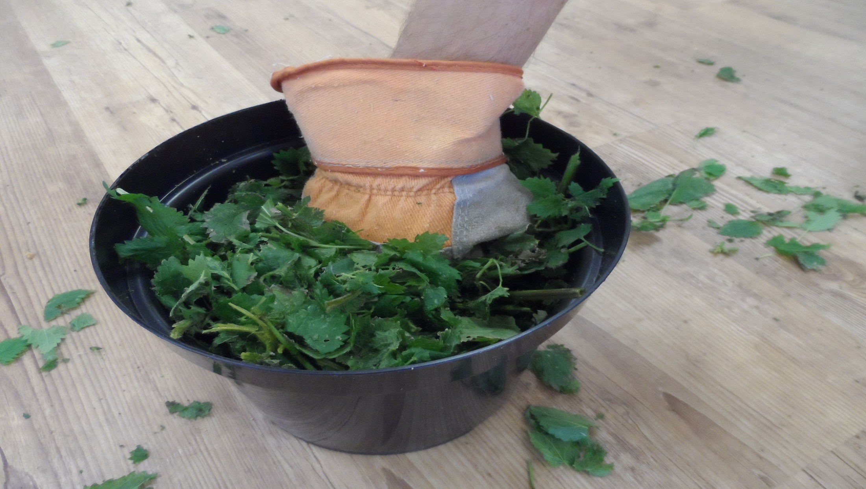
STEP: 6 Force as many nettles in the pot as possible.

Slide 9
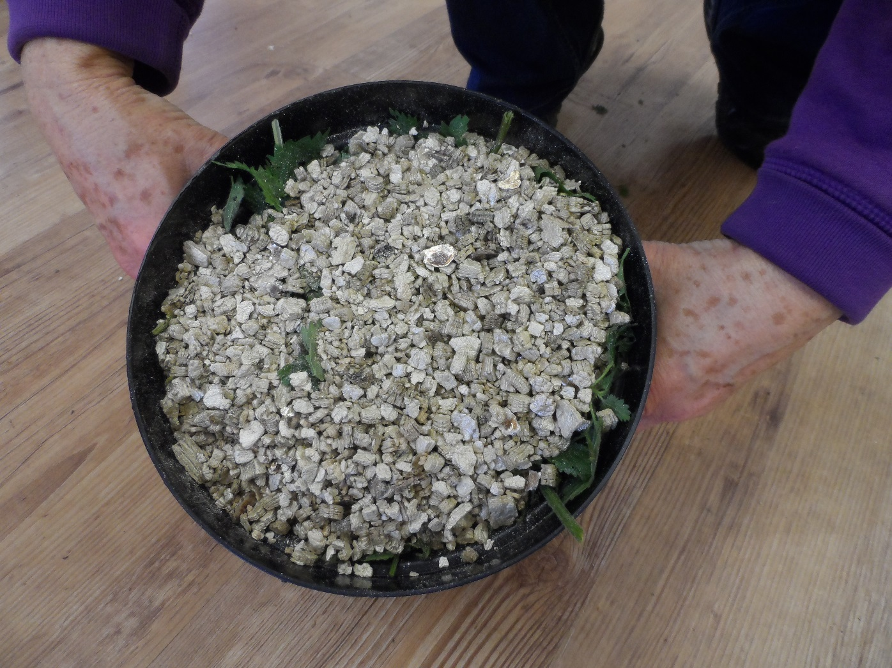
STEP: 7 Place a 7.5cm pot full of vermiculite on top of the nettles.

Slide 10
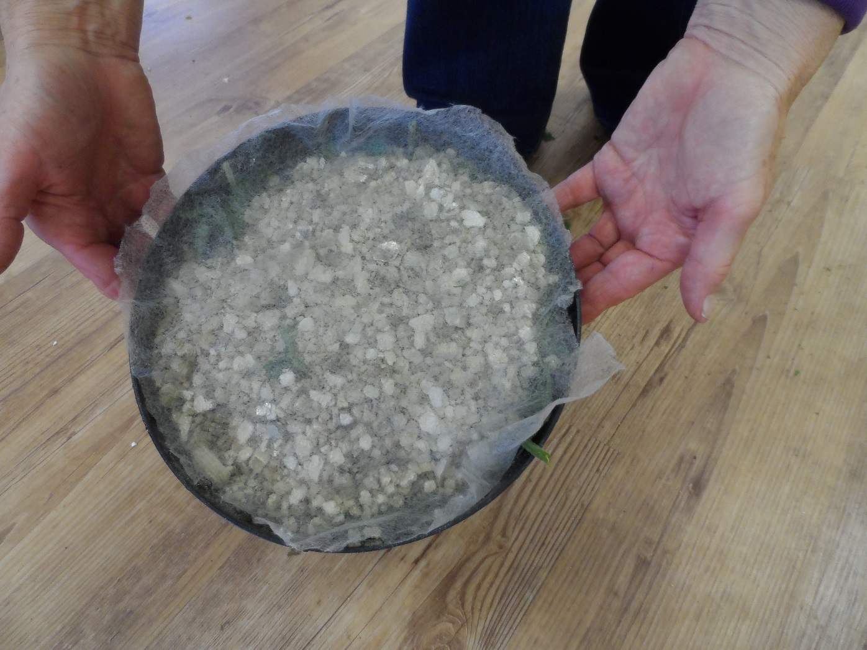
STEP: 8 Place fleece over the vermiculite.

Slide 11
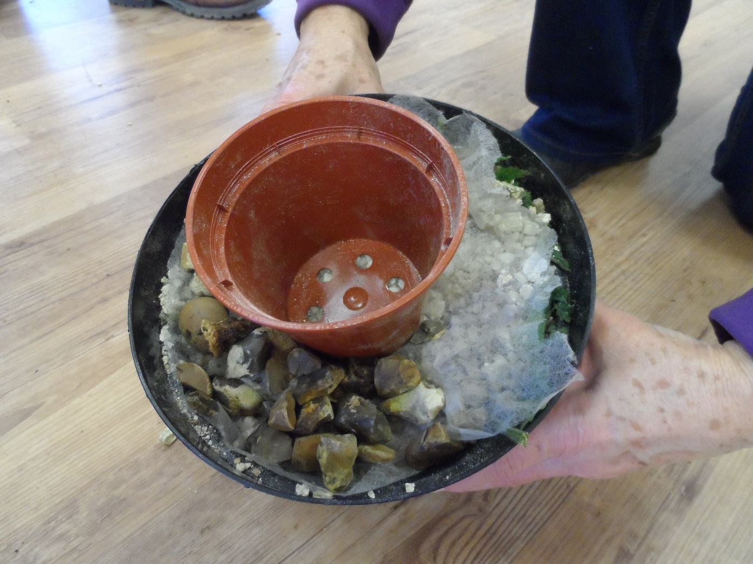
STEP: 9 Place a 7.5cm pot in the middle and cover the fleece with aquatic stone.

Slide 12
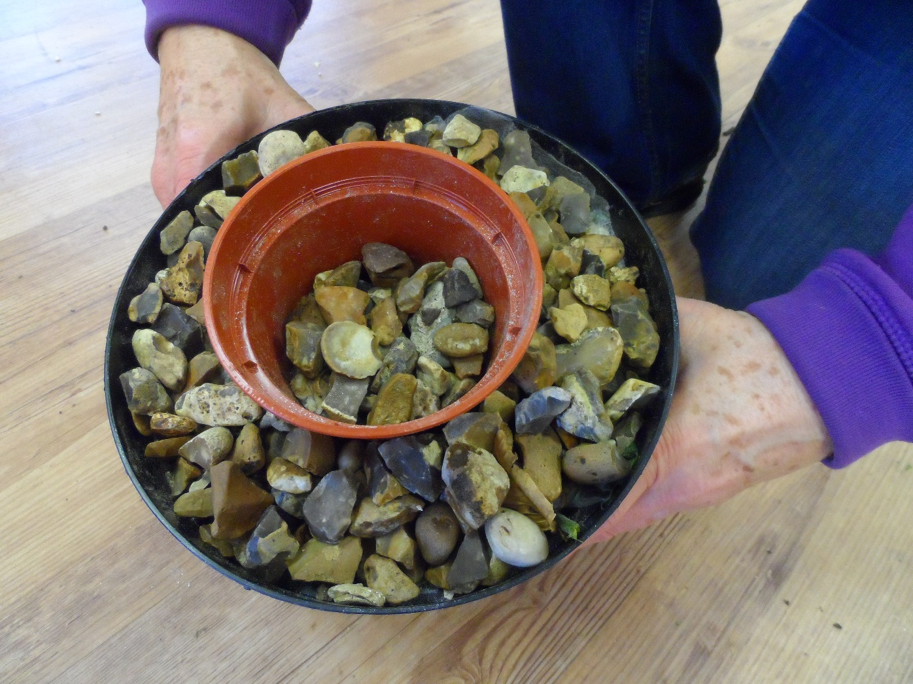
STEP: 10 The finished result. Place aquatic stone in about one third of the pot.

